Slide 1
G Suite Elevator Pitches
Google Maps

Slide 2
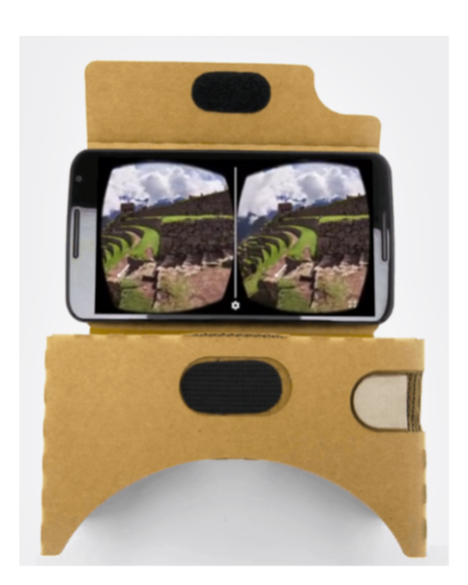
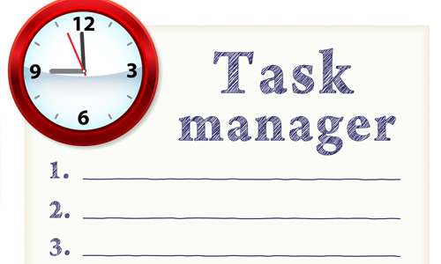
Google Expeditions

Slide 3
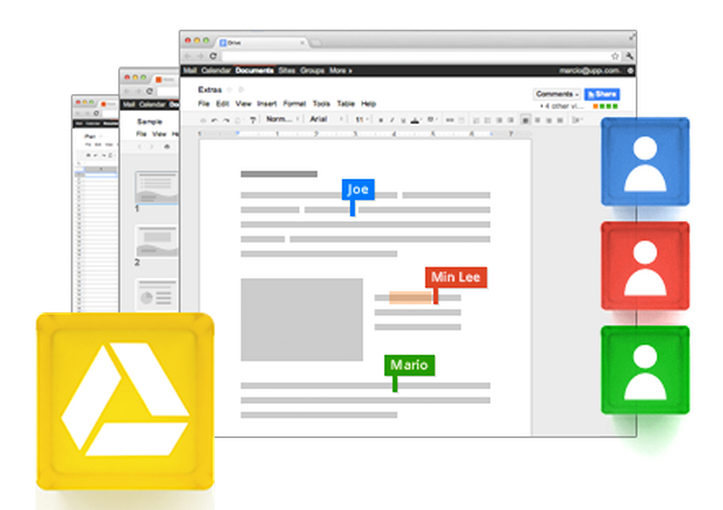
Google Drive
What is it?
It’s a cloud where you can…
organize/store all your stuff!
collaborate/share with colleagues and students
It’s the THING that ties everything else together!
Classroom Examples
students collaborating with peers and teachers
Speedbumps
Organization is key! Create folders!
Use the search tool for “Shared with Me”

Slide 4
Google Docs
Table 2
Shareable documents that multiple people can edit at once.
You can see when the student finished work.
It’s free!
Need to add accents with ALT codes or insert special characters (or change language). CTRL codes from MS Word do not transfer over.
Spacing can get messed up (last week). Students had to learn to print as PDF. I believe that Google has fixed this now.
Students expect their teacher to print for them, but we don’t have time. We are not set up to edit online; it is very time consuming to make multiple comments on a GoogleDoc.

Slide 5
Google Slides

Slide 6
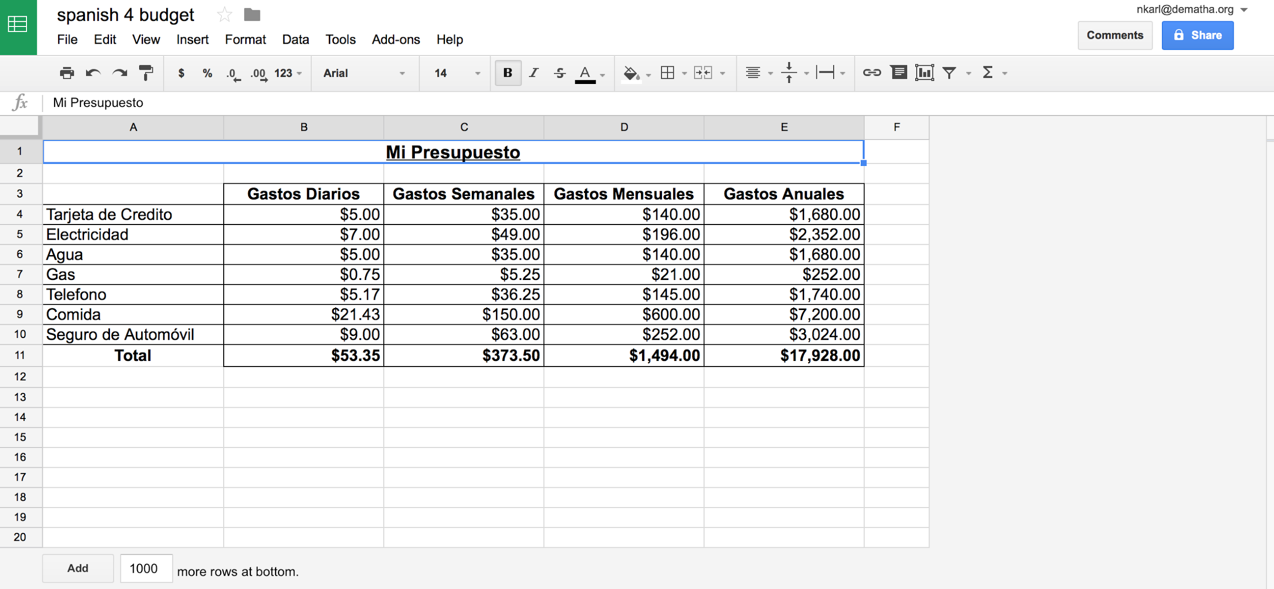
Google Spreadsheets

Slide 7
The spreadsheet activities have to be collaboration and interpersonal like :
planning the budget for a trip or if the student goes abroad how much money would they need. Students work in pairs to create their budget
Speedbump - staying in the target language

Slide 8
Google Forms
Teacher Surveys of Students - View Whole-Class Results
Students Create Surveys - Collaborate to Edit - Present Results
Teachers Create a Quiz for Students
Students Create a Quiz for Students
Speedbumps: Some limitations in grading/feedback ability. Not necessarily interpersonal
http://www.flubaroo.com/hc/quizzes-in-google-forms

Slide 9
Google Sites
Allows the teacher/student to easily share information with the community at large by building websites. Students can use Google Sites to create a portfolio for all of their work over their school career and publish it for colleges to see. Students can create projects that they can share to solve problems.
Possible Speed Bumps: In some cases, educators prefer Google Classroom or other classroom management software. They feel it is more organized but parent and community access to Google Classroom is limited while Sites can be made public for anyone to view.
Classroom example: Students can build a website to show what they know and display it for the world to see.

Slide 10
Google Communities
What is it?
Shared space for students and teachers
Pros
Secured to the classroom only
Share links, pictures, etc.
Leave comments
Facebook for the classroom
Pinterest board for the classroom
Get notifications when someone posts something new
Potential Challenges
Active participation
Might be redundant if you already have a student management system

Slide 11
Google Classroom
What is it: Interactive online classroom
Classroom examples: Create projects and upload them, exit and entrance ticket questions. Embed files from youtube, google drive, link websites and add attachments.
Pitfalls: All students must have a Gmail account.
Instant distribution of information to students.
Ability to grade within the program.
Students have the ability to comment on other’s comment or you can turn it off.
Schedule when assignments appear.
All information stays year after year until you delete it. You can change the date.

Slide 12
YouTube
Advantages
1.You can record and share or watch yourself. Benefit of speaking and correct yourself
2. It has authentic materials.eg watch commercials etc
3.You can get short videos,watch the section you want etc
4.You can use it to learn culture.
Problems
Proasily distracted, sometimes blocked, sometimes inappropriate content

Slide 13
Google Maps:
Access your logistical learners!
Create buy-in through freedom of choice
Any activity regarding geographical location - how to get from one place to another, exploring a city itself, finding restaurants or hotels, etc.
Can overlay Google Earth and Satellite view to see topographical area Can go to Street View - Can create their own maps - Can narrate a tour themselves
Timeline feature - connects to phone
Can change the language to be in target language (speedbump - they can change it back to English)

Slide 14
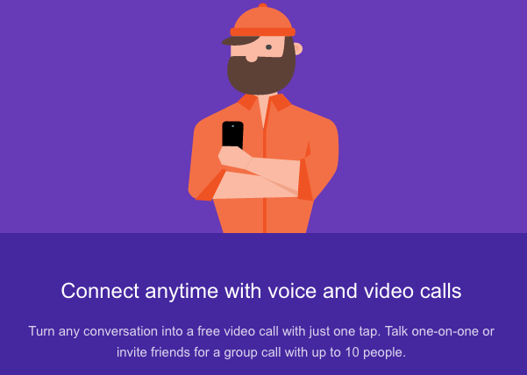
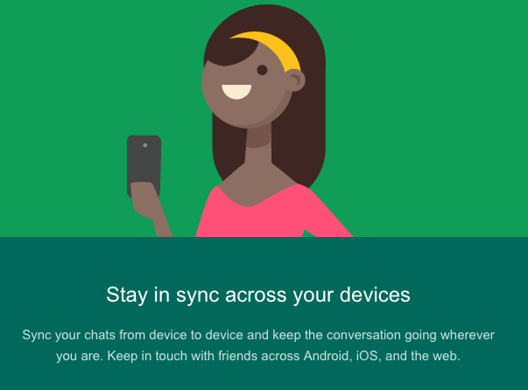
Google Hangouts
PROS
-Real time conversation
-Ability to review text conversation
CONS
-Great for live video chat, but if you can’t go live it is only text.
Questions:
-Are the videos archived?

Slide 15
Google Keep
WHAT IS IT
Post notes, reminders, and links in one location, audio or written
FEATURES:
Access info quickly by tagging
Access from multiple device
Organize links, notes lists easily
Notes and reminders
CLASSROOM USE
Create a checklist for students to keep track of work completed
Collaboration for group work: a place to keep research, notes etc

